Slide 1
Savannah
Notes:
Hello, my name is Alan Pope
You may know me from videos such as “What are beans?” and “Extreme trampolining” before a prior oggcamp in Farnham
Alternatively you may know me from podcasts like LInux Matters, which is excellent, and you should listen
Search Linux Matters in your favourite podcast client
But this is not about me, I’m here to tell you about Savannah
I am not a Savannah developer, but I am an enthusiastic new user

Slide 2
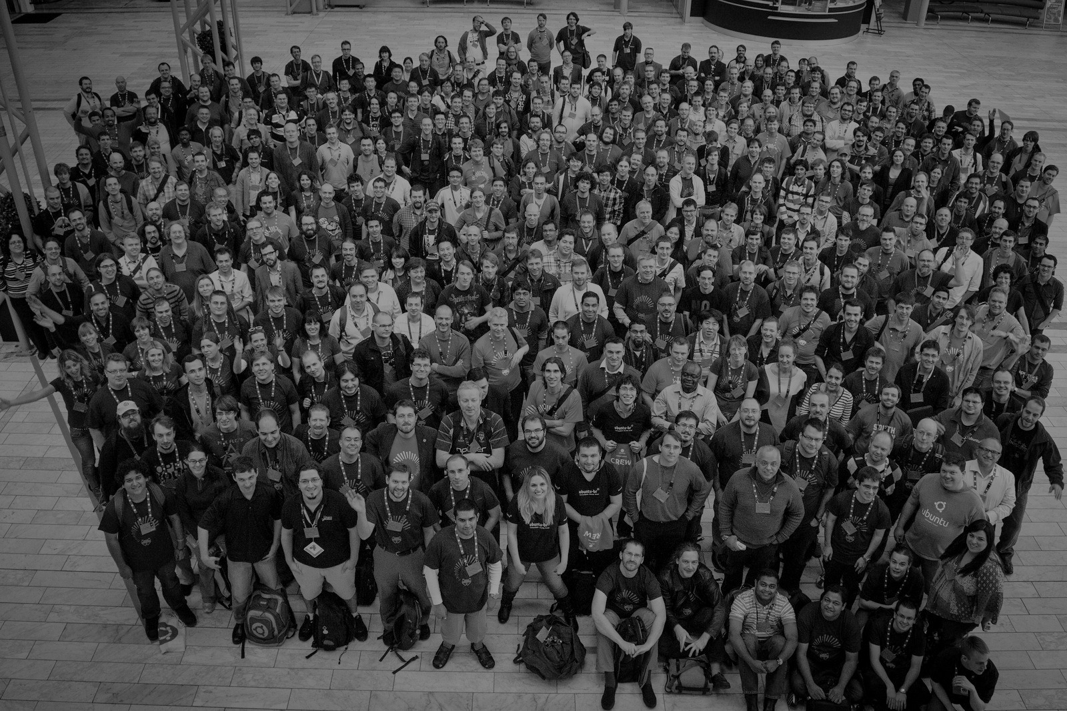
Community
Health
Notes:
This talk is all about community health, which may mean different things to each of you.
What that means to me is in an open source project:
Are we gaining or losing members of our community?
Do we recognise and mentor new members of our community?
Are people’s contributions valued?
Do we even know who the members of our community are?

Slide 3
A question…
Notes:
First a question - show of hands
Do you identify as a member of an Open Source community?
And/or Do you perhaps have some kind of leadership role in an open source project or community?
This is a photo of myself and the Internet’s Jono Bacon. (I’m on the left, with the hair)
I think this photo is from 2010 or so.

Slide 4
Michael Hall (mhall119)
Developer Evangelist - ARM
Previously:
InfluxData Linux Foundation Endless Inc. Canonical
Savannah
Notes:
Savannah is a ‘side project’ by Michael Hall - A developer evangelist and community manager of over a decade
He’s a friend of mine who I worked with at Canonical, and later Influxdata.
I am also a paying customer of Savannah
Over some years, Michael wrote and maintained some scripts to monitor the health of various communities he was involved in
This eventually became Savannah
Sadly Michael couldn’t be here today, so I am here in his stead

Slide 5
.. is Community Relationship Manager (CoRM)
savannahcrm.com
Savannah
Notes:
Here’s the introduction text from the Savannah website, savannacrrm dot com
Let’s pick out a few highlights
Savannah is a “Community” relationship manager which borrows some terms from Customer relationship management applications

Slide 6
.. is Community Relationship Manager (CoRM), it gives you a holistic view of your community
savannahcrm.com
Savannah
Notes:
A holistic view, meaning across all your platforms

Slide 7
.. is Community Relationship Manager (CoRM), it gives you a holistic view of your community, helps you identify key
members
savannahcrm.com
Savannah
Notes:
Identify key members, because in a moderately decent sized open source community, it can be easy to lose track of who is doing what..

Slide 8
.. is Community Relationship Manager (CoRM), it gives you a holistic view of your community, helps you identify key members, track engagements
savannahcrm.com
Savannah
Notes:
It can also be hard to keep track of what everyone has worked on, their specialisms

Slide 9
.. is Community Relationship Manager (CoRM), it gives you a holistic view of your community, helps you identify key members, track engagements with and between individual members, and allow you to make data-based decisions
savannahcrm.com
Savannah
Notes:
So you can make data based decisions

Slide 10
.. is Community Relationship Manager (CoRM), it gives you a holistic view of your community, helps you identify key members, track engagements with and between individual members, and allow you to make data-based decisions to increase the health
savannahcrm.com
Savannah
Notes:
Which influence the community should be based on data rather than randomly throwing things at the wall to see what sticks

Slide 11
.. is Community Relationship Manager (CoRM), it gives you a holistic view of your community, helps you identify key members, track engagements with and between individual members, and allow you to make data-based decisions to increase the health and growth of your community.
savannahcrm.com
Savannah
Notes:
As a community leader, it can be easy to take your eye off the ball, and miss the great work your community is doing
Savannah is designed to make it easier for you to keep track of community contributions and conversations
Savannah enables you to very quickly get an overview of how your community is doing across multiple platforms, aggregating contribution data

Slide 12
Conversation
Notes:
Savannah at the heart captures and measures contributions and conversations
Conversations can occur in many places - discussions on bugs, support or development planning on forums

Slide 13
Contribution
Notes:
Contributions can also occur in those places - but also often in the form of code, documentation, translation, events and so on

Slide 14
Data Sources
Notes:
Let’s talk about sources of data
Savannah has a rich set of sources to gather community data from
Can we name all these brands, starting left to right, shout out…
Shout them out in order…
Simply point savannah at a source and it will start gathering public data via those APIs about the contributions and conversations happening
So whether your community conversations happen on Slack, Discord or Discourse, you can import them
If there’s no source available for your platform, there’s an API to insert data about members, and their contributions

Slide 15
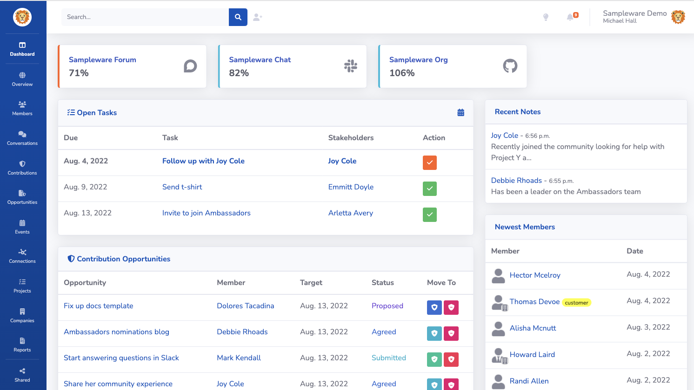
Notes:
Savannah is a web based tool which looks like this, it’s pretty straightforward but quite comprehensive

Slide 16
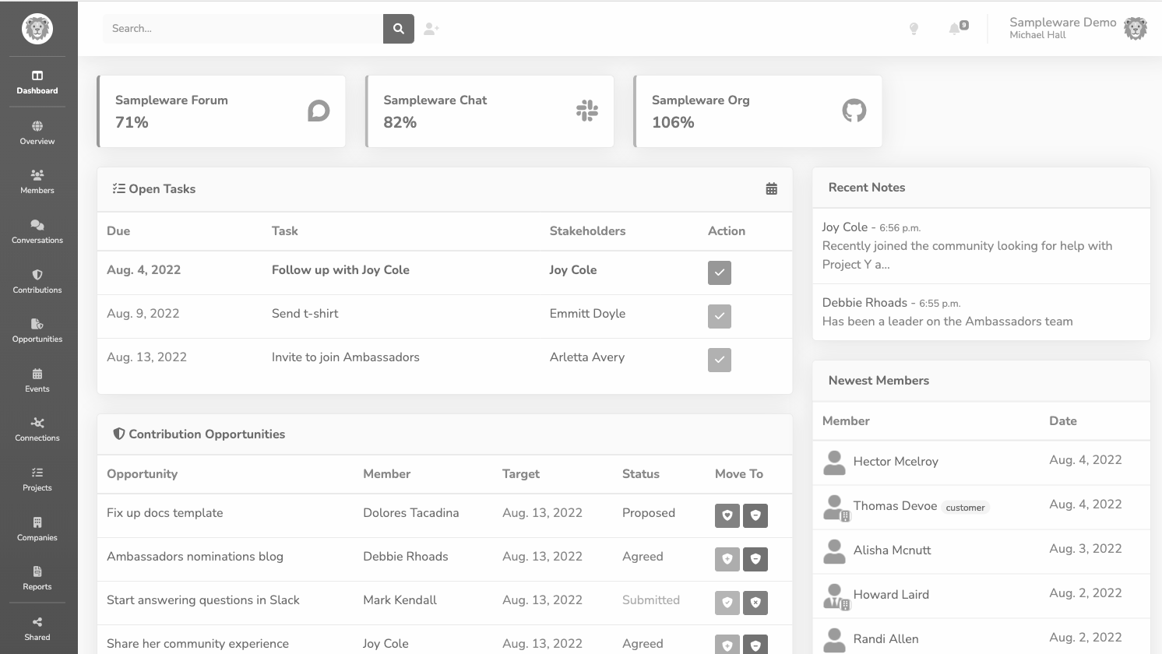
Quick Tour
Notes:
Let’s just have a brief tour of some health information you can gather from the main ‘Dashboard’ view
Note the bar down the left is for navigation.
This is the ‘Sampleware’ demo data, I’ll show you some real world data from today in a bit

Slide 17
Notes:
In this sample dataset, the forums are 71% as active in the last 7 days relative to the previous 30 days

Slide 18
Notes:
The slack is 82% as active this week, compared to last month
This might look bad, but that’s not necessarily a disaster, projects wax and wane over time
Perhaps this was just a holiday period?
(note the dates around August, so this could be plausible)

Slide 19
Notes:
The github org is about the same this week as the previous month

Slide 20
Notes:
Savannah lets us leave notes on people’s activity - much like any Customer Relationship Management application
Here the community manager made a note that Joy Cole joined looking for help with a project.

Slide 21
Notes:
We can also create tasks, like a to-do list.
In this example we have a task to follow up with Joy Cole, who we noted has recently joined the community,

Slide 22
Notes:
There’s some tasks here that the community manager added to follow up with individual contributors
Sending a t-shirt
Checking in with someone
Inviting an expert to join an ambassador programme

Slide 23
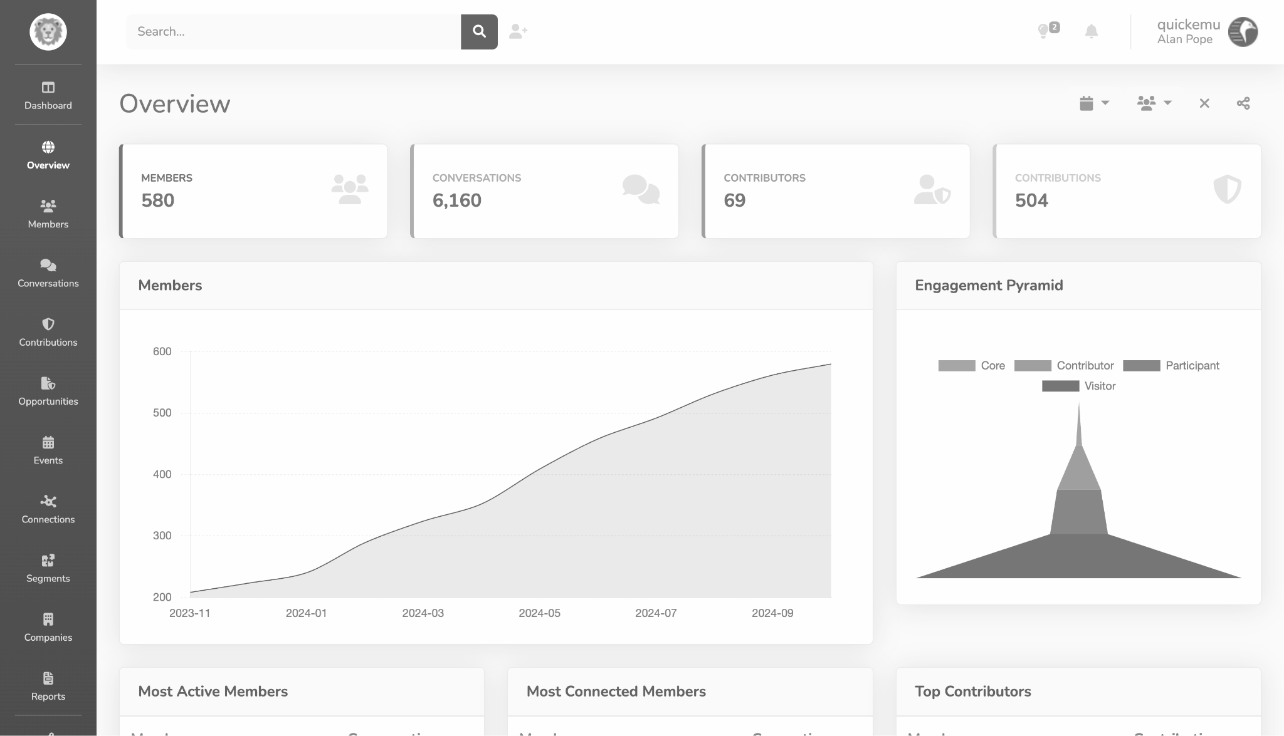
Real Data
Notes:
The rest of these screenshots this morning from the Quickemu project

Slide 24
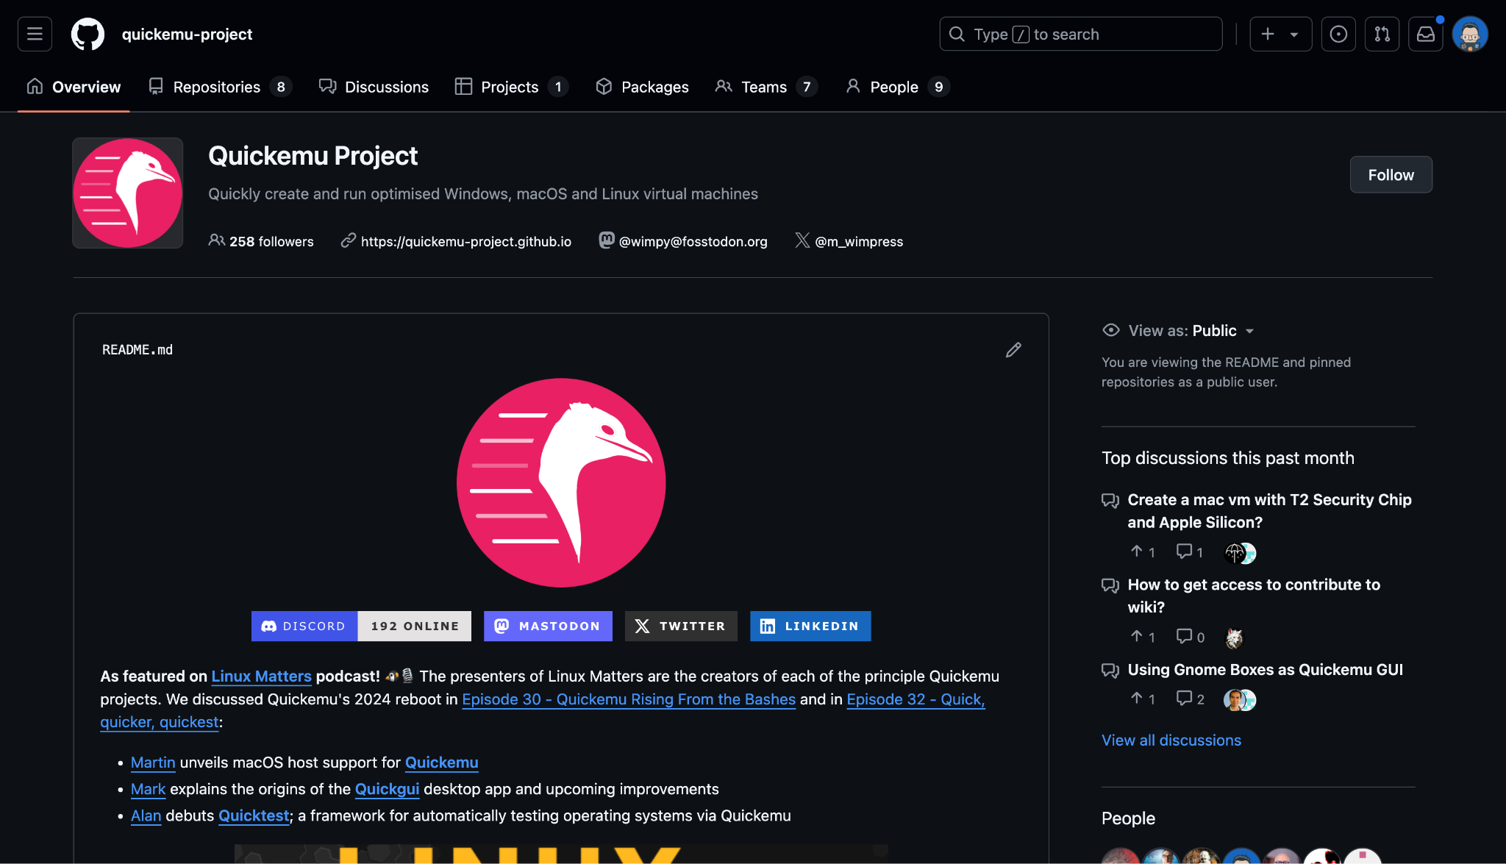
Notes:
For those who don’t know, Quickemu is an open-source project started by Martin Wimpress as a way to easily create & launch virtual machines.

Slide 25
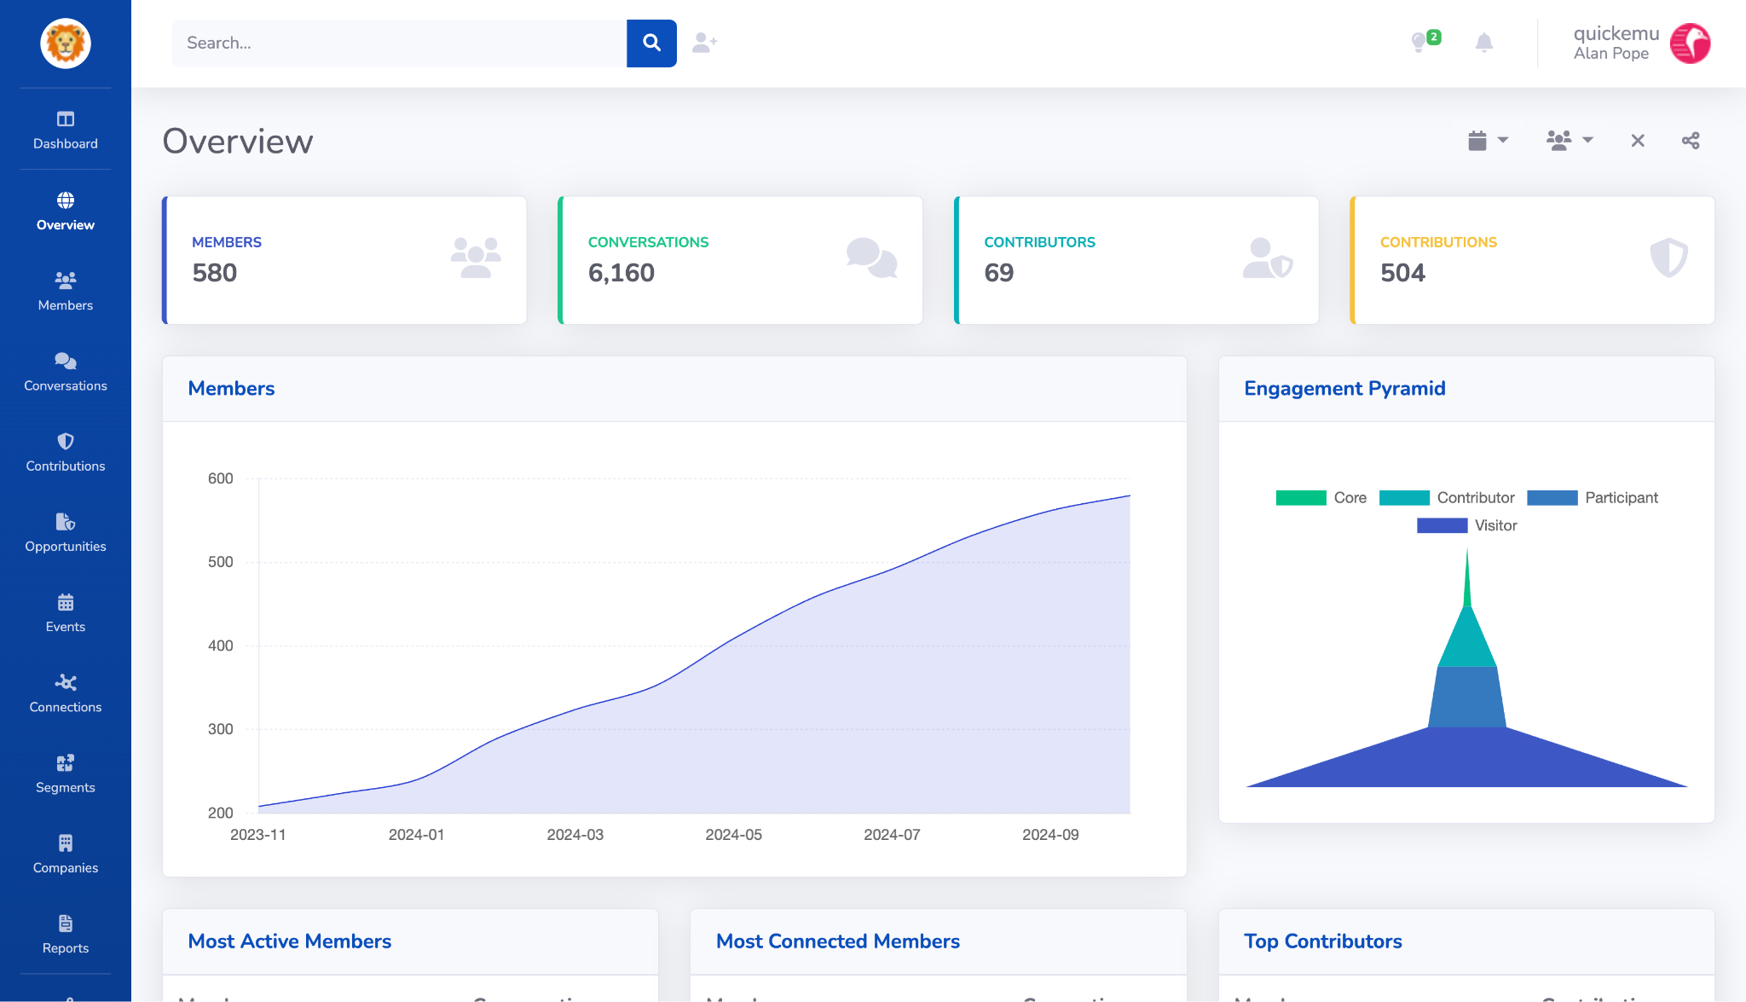
Notes:
In the overview screen we see how many members are in the community
How many conversations (wherever they happen - discourse, discord, github, slack)
How many contributors there are and how many contributions
Note that this data goes back a year

Slide 26
Notes:
Note that this data goes back a year

Slide 27
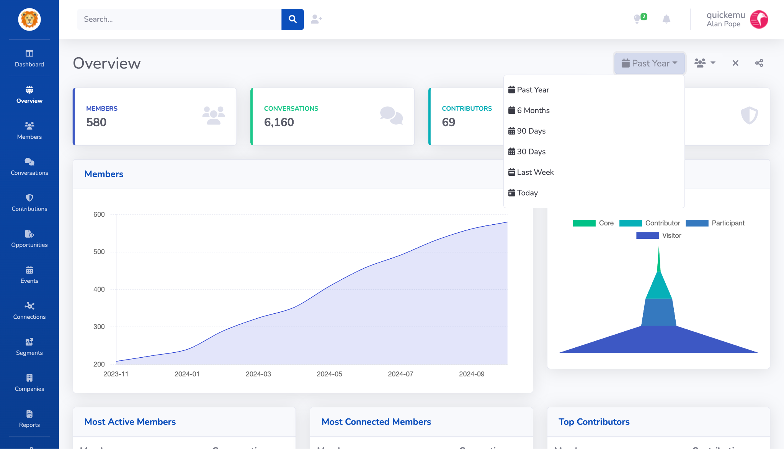
Notes:
Up here we can filter the data down to a more recent period

Slide 28
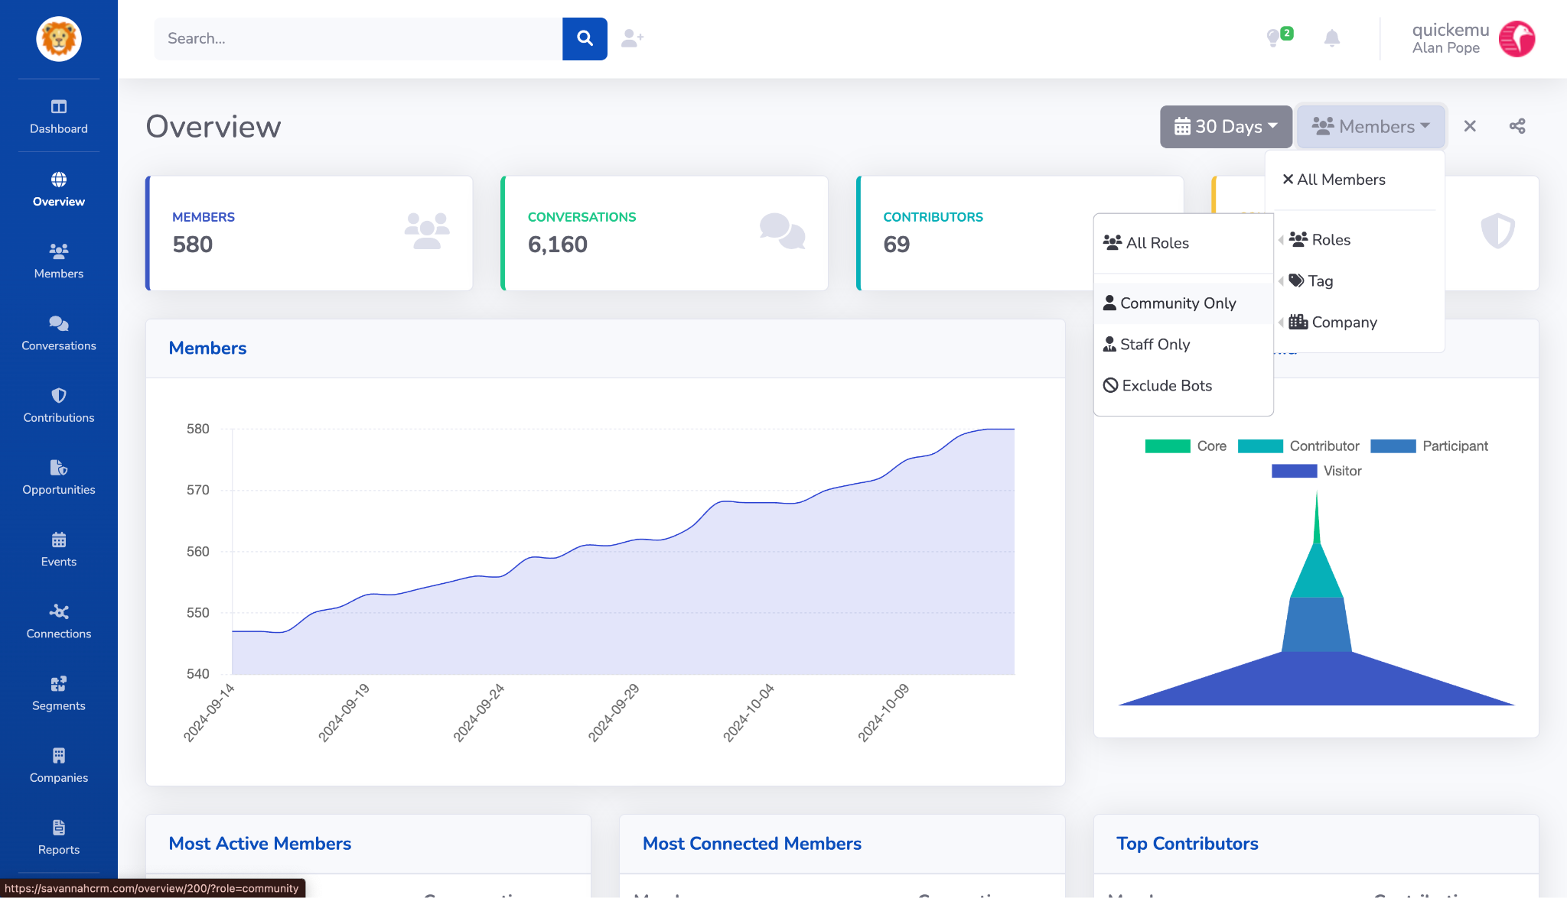
Notes:
If the open source project has concept of paid staff and external community members, we can also filter out the staff members, to focus our attention on external contributors.

Slide 29
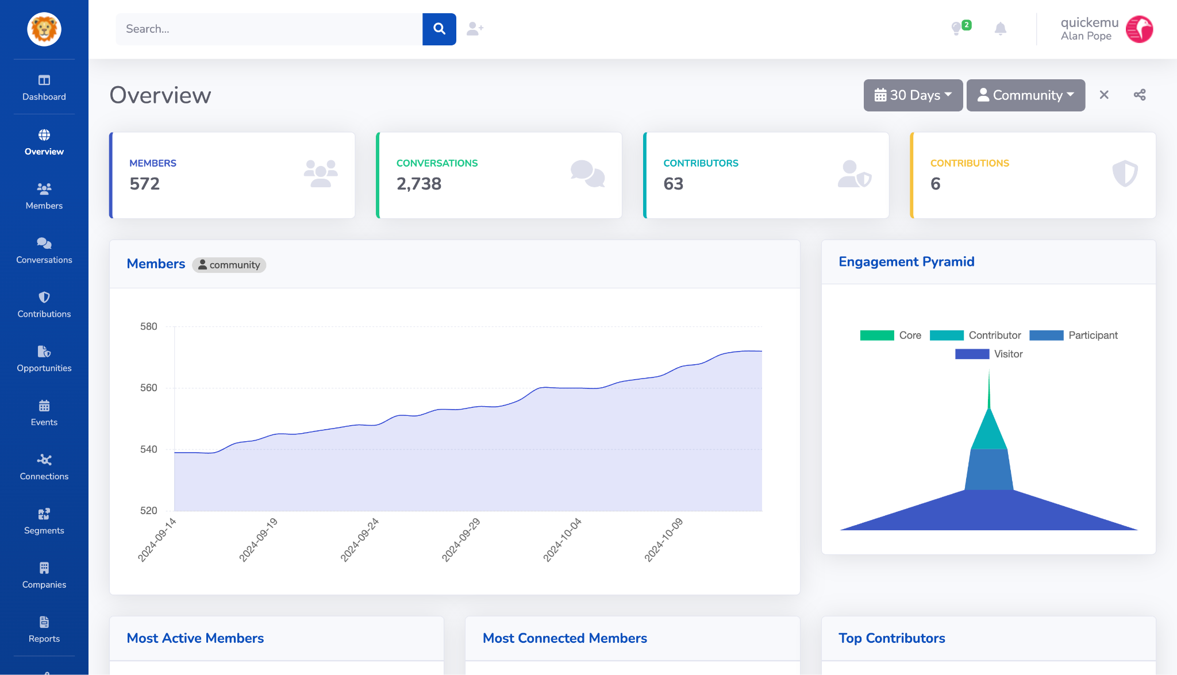
Notes:
This engagement pyramid is showing the progression of numbers of visitors (people who do a drive by issue report for example) through participants (who return) to contributors (who provide patches etc) and core (who are regular contributors)
The shape of this varies by community, and the way they foster users through the contribution flow

Slide 30
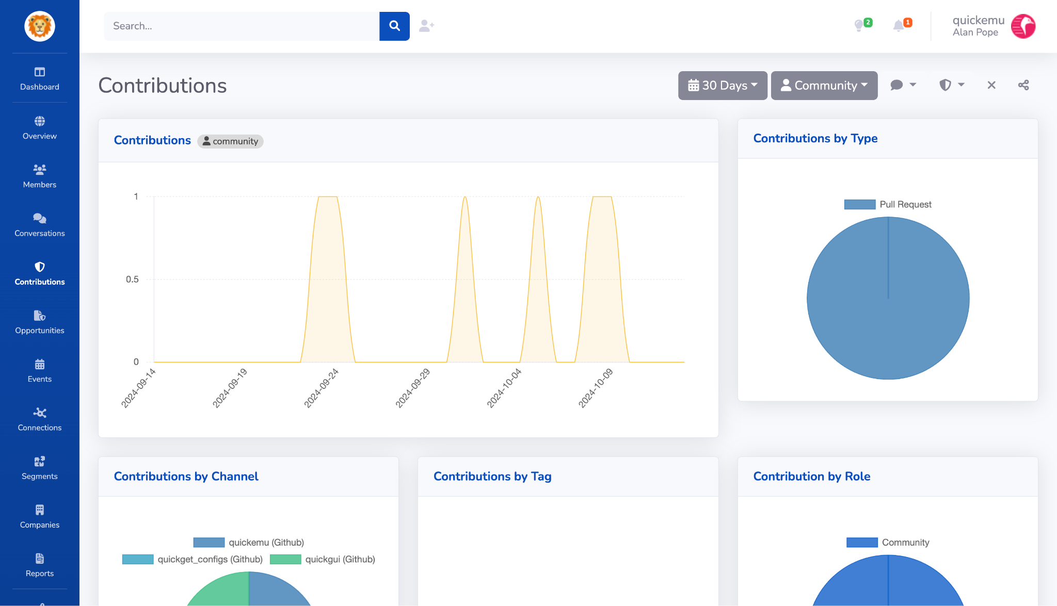
Notes:
Here’s a quick summary of the number of contributions from the community over the last month
These are all pull requests, and have been made to quickemy itself, quickgui, and quickget_configs ‘channels’
(channels in savannah are essentially the part of sources, so one channel in this case is one GitHub Repo)

Slide 31
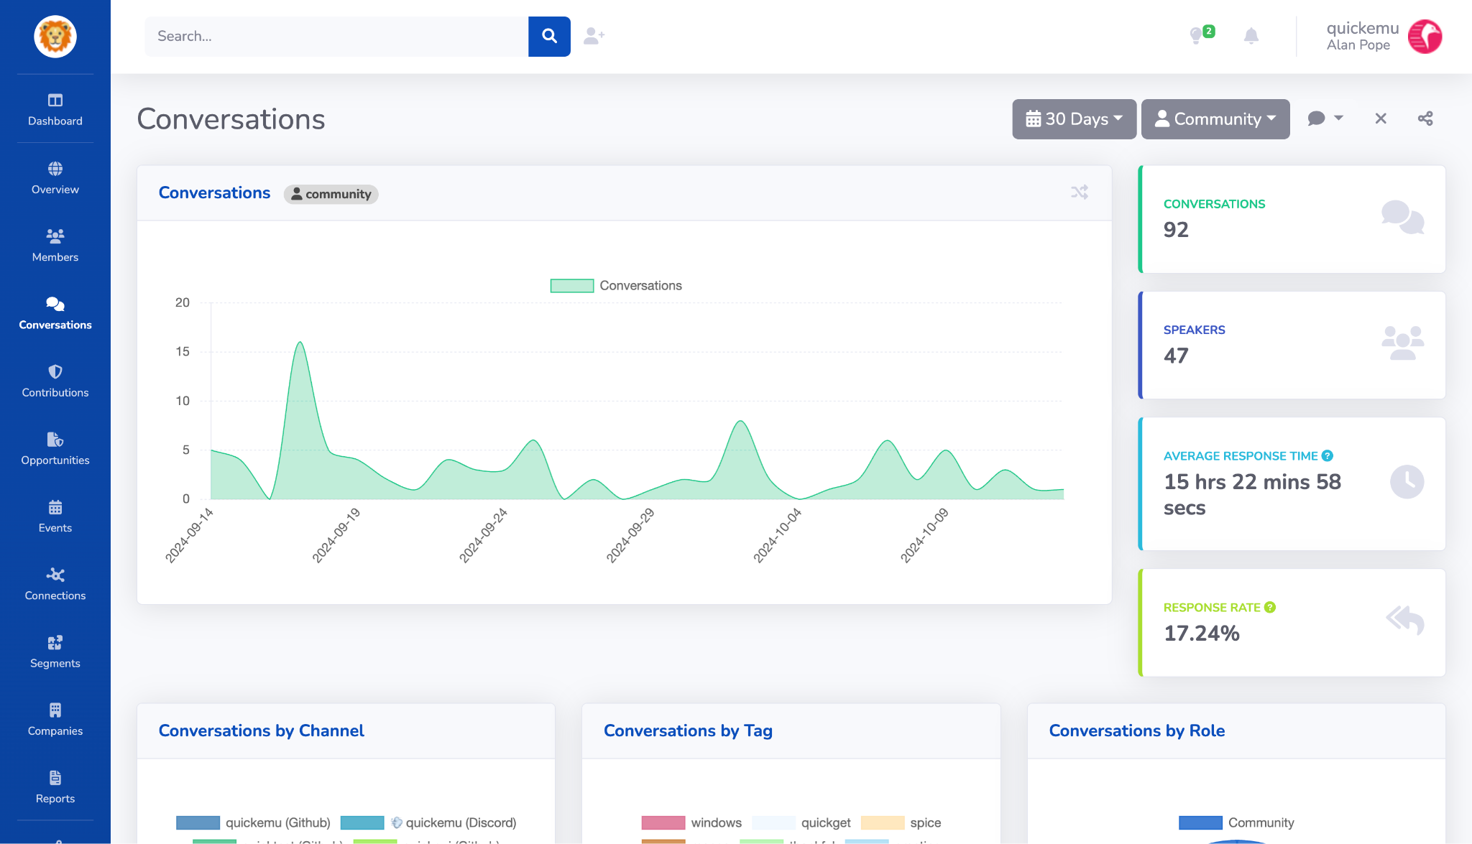
Notes:
Conversations are also happening on github and discord

Slide 32
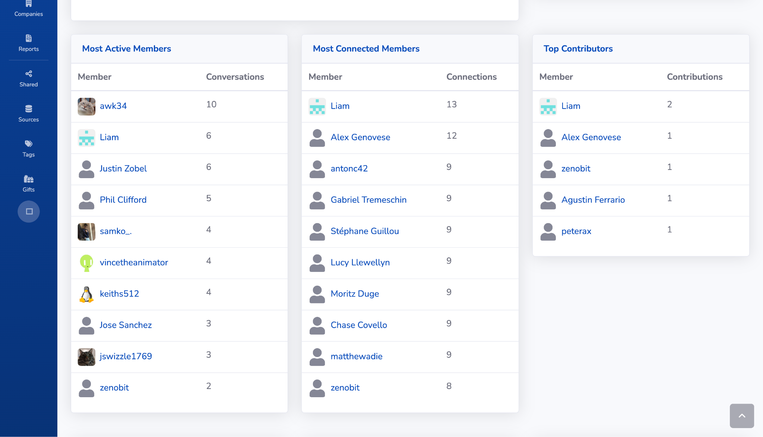
Notes:
We can drill down on these contributions and conversations
Here we can see the most active members of the community over the last 30 days
Let’s just drill down on one active member, Phil Clifford

Slide 33
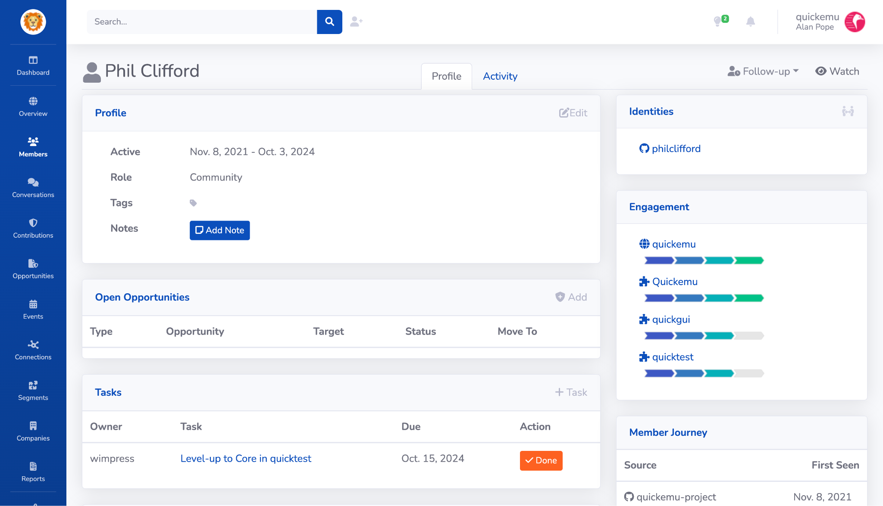
Notes:
This is Phil’s page
Savannah can merge multiple identities into one
For example if someone is active on Github and Discord, you can merge those identities into one member

Slide 34
Notes:
Here we can see that Phil is active across multiple segments of the community
They’re also considered a ‘core’ contributor in quickemu itself.

Slide 35
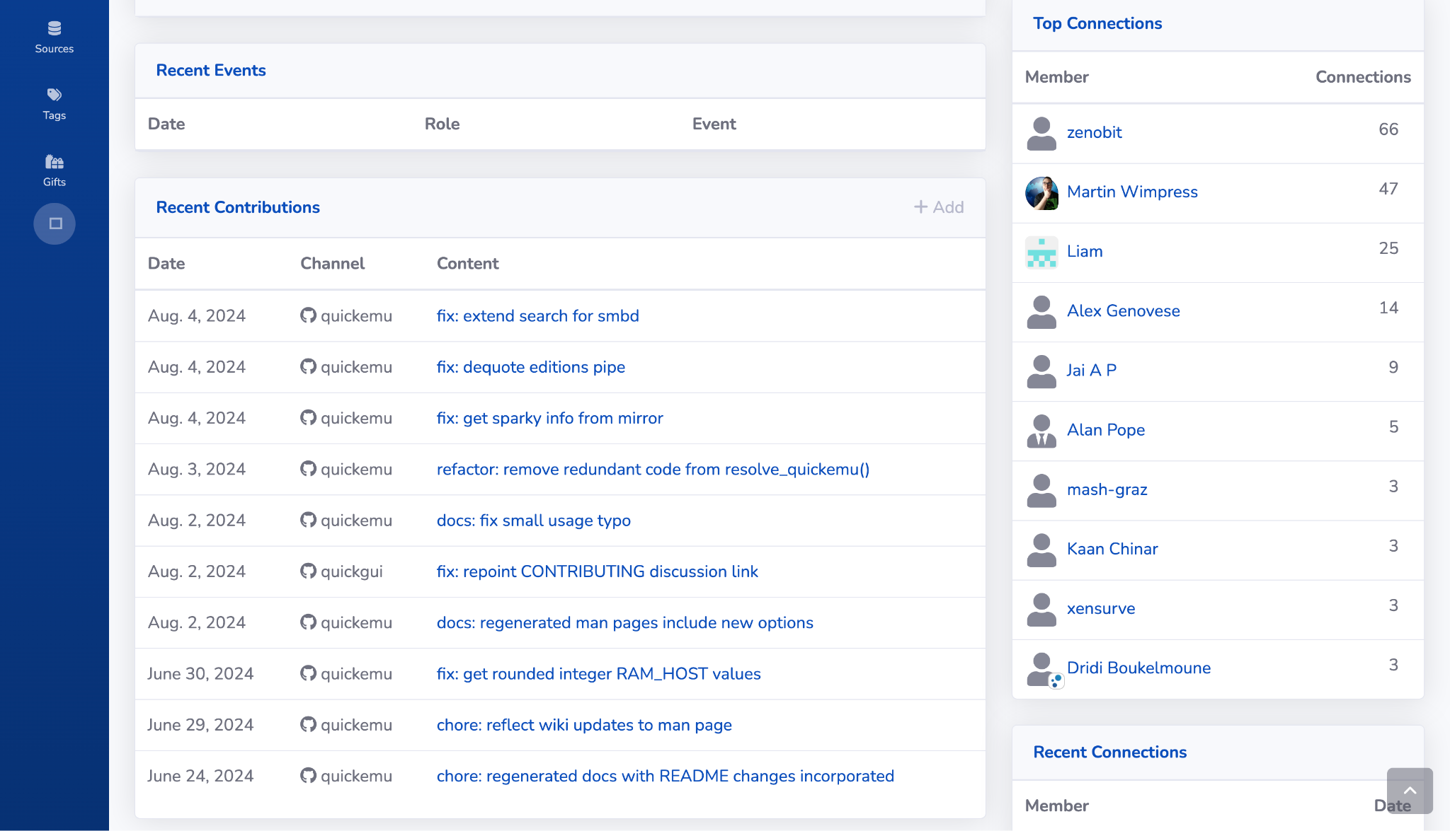
Notes:
If we scroll down, we can see all the contributions that Phil has made recently
These link to (in this case) github, so you can see the contributions directly.

Slide 36
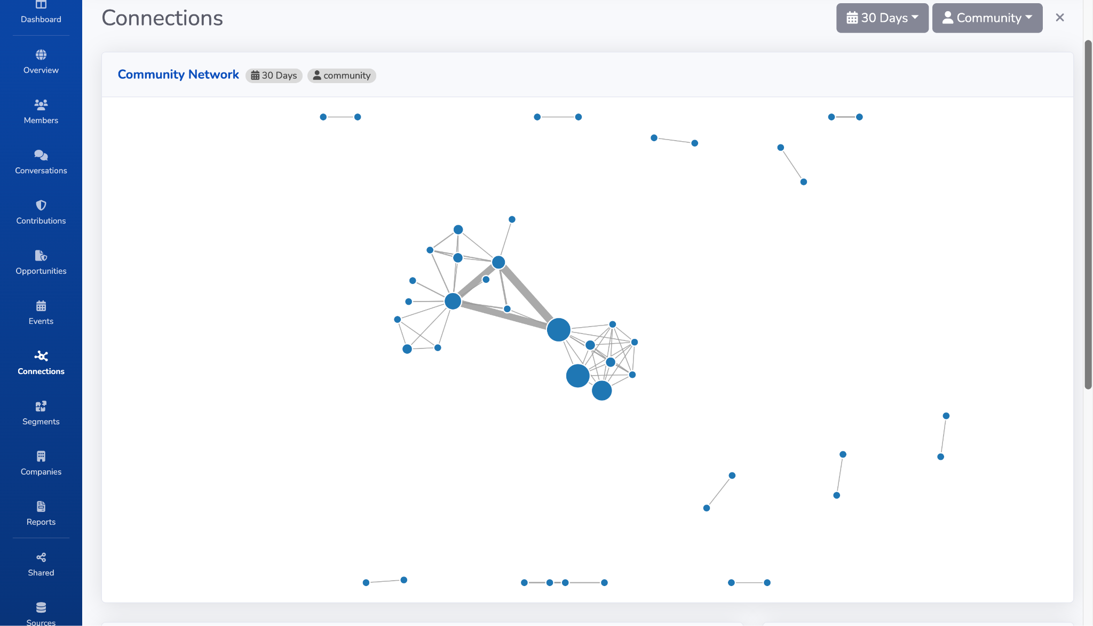
Notes:
Savannah can also illustrate the connections between members
So we can see who converses with who, who often reviews and merges other people's contributions
This can be useful data for mentoring new people who are looking for existing people who work with, we can see who is active

Slide 37
Reporting
New members & contributions
Engagement levels
Regular health reporting
Connections network
Tasks & opportunities
Watched community members
Identify potential core contributors
Notes:
Some of the things Savannah can highlight - some examples
New people who may not know the ropes, so may benefit from additional help
What is the trend in engagement? Where engagement is falling off - e.g. no new tasks for contributors, or visible activity from core members
Automated reports to compare this month to last month, this year to last year.
Who is interacting with whom in the community. Do we have ‘rockstars’ who may also a potential single point of failure if they leave?
Opportunities for mentoring new members who are looking for guidance
In a large community, watching specific people, so they don’t get forgotten

Slide 38
Demo

Slide 39
Summary
Provide Community insights
Via metrics, charts & reports
Using real-world data
At no or low cost
Is easy to set up
Has popular data sources
With a simple API

Slide 40
Questions?
Notes:
Got any questions?

Slide 41
savannahhq.com
Thank you
Notes:
Find out more, and try it out at savannahcrm dot com.

